Slide 2


Moving Forward …
In A Way …
That We Haven’t …
Moved Before ….

Slide 3
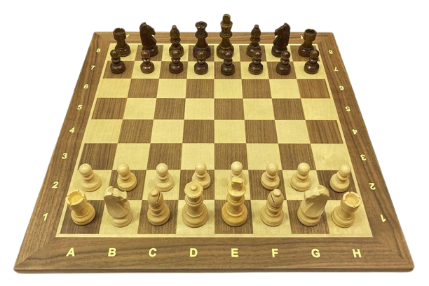
CHESS
BOARD
PIECES

Slide 4
PAWN
PIECES

Slide 5
ROOK
MOVES

Slide 6
UNITY
PRAYER
FASTING
? GIVING

Slide 7
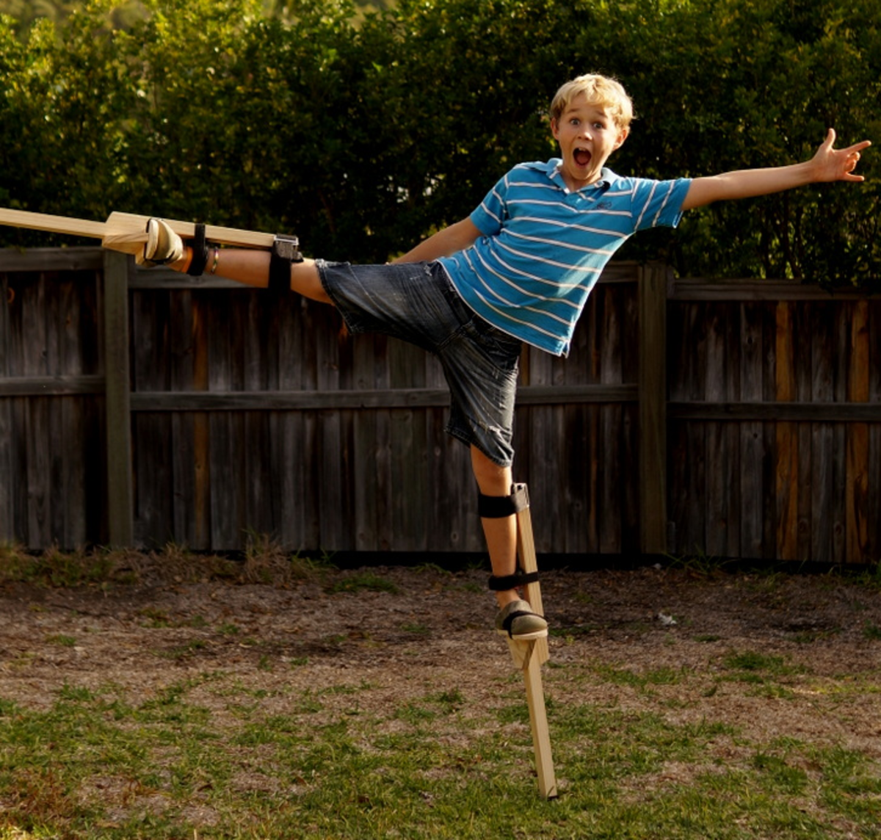
STILTS

Slide 8
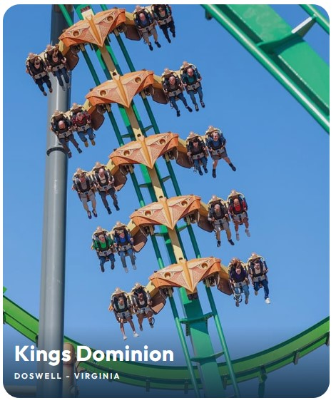
THEME
PARK
RIDES

Slide 9
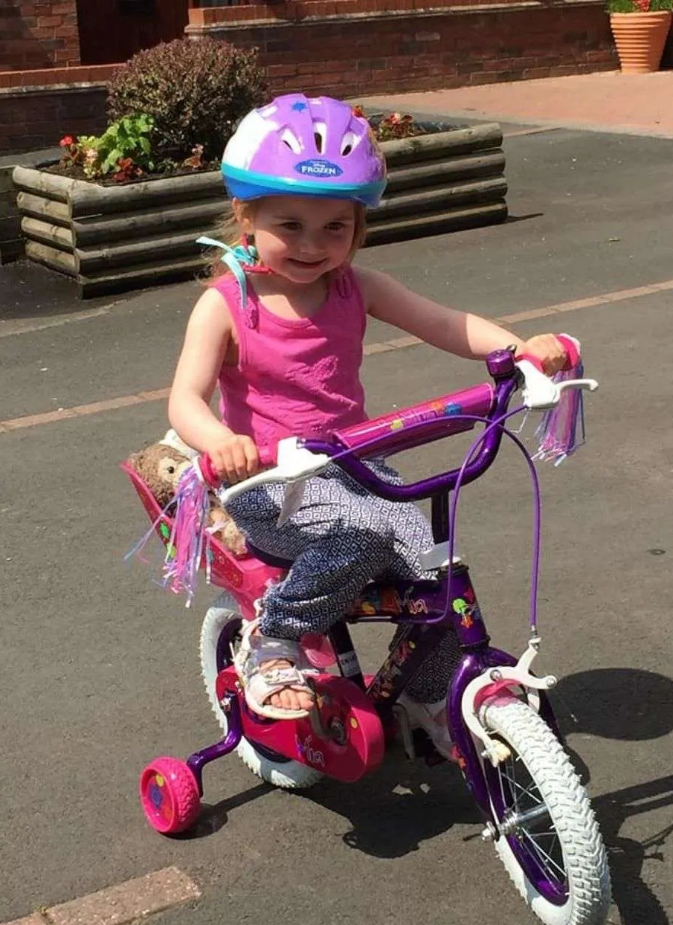
BICYCLES
WITH
STABILISERS

Slide 10
Moving Forward …
In A Way …
That We Haven’t …
Moved Before ….

